Slide 1
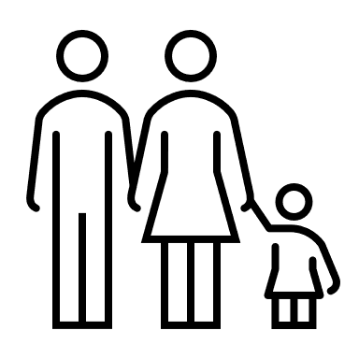
Perceived Barriers and Unmet Primary Healthcare Access Needs of Iranian Immigrant Women in Canada
Nazanin Abolghasemi Taree, Nashit Chowdhury, Hasti Masihay Akbar, Turin Tanvir Chowdhury*
Cumming School of Medicine, Department of Family Medicine, University of Calgary
Background
Objectives
Canada is a popular destination for immigrants, necessitating equitable health care access for all. However, accessing healthcare for immigrants in Canada is a complex endeavor fraught with numerous challenges.
It is imperative to systematically identify the barriers faced by various immigrant communities to access health care, especially those relatively less studied and smaller in size characterized by their distinct language, culture, and socio-economic backgrounds.
Iranian immigrant women in Canada face significant challenges when seeking primary healthcare (PHC), and this can negatively impact their well-being
There is limited literature detailing the experiences of Iranian immigrant women within the Canadian healthcare system.
We intend to comprehend the perceived barriers and unmet primary healthcare access needs of Iranian immigrant women in Canada and explore ways to redress them.
1
Community-based participatory approach
Descriptive phenomenology to learn from the lived experiences
Discussions in Persian, the participants' preferred language
Descriptive analysis for examining socio-demographic characteristics
Reflexive thematic analysis to synthesize the findings
Purposive recruitment of those with experience of accessing PHC in Calgary, Alberta
7-8 focus group discussions using a semi-structured guide
Methods
Results
Conclusions
We anticipate discovering a number of healthcare access barriers faced by immigrant women in Canada, including certain barriers unique to them. These potential barriers might include:
prolonged wait times for emergency services
Slow treatment processes
Few numbers of female healthcare providers
Preservation of modesty during medical exams.
With more in-depth analysis, we also anticipate identifying the mechanisms underlying these barriers, such as:
limited understanding of the Canadian healthcare system
difficulty accessing healthcare centers
unfamiliarity of where to seek appropriate care
We expect to identify the repercussions of these barriers manifesting in various ways within this population.
Study provides foundation for understanding healthcare needs and barriers of Iranian immigrant women in Canada.
Paves the way for tailored strategies for this community and enhance healthcare access for the community.
Assists stakeholders in providing culturally competent care and in promoting equal healthcare for all.
References
…
Nazanin Aboulghasemi, aboulghasemi.na@gmail.com
Turin Tanvir Chowdhury, turin.chowdhury@ucalgary.ca

