Slide 1
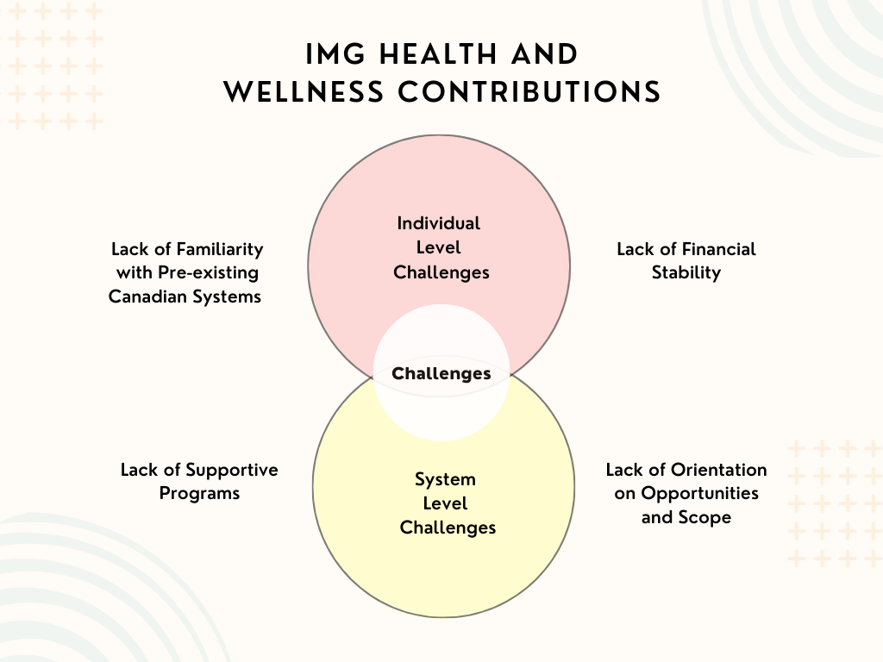
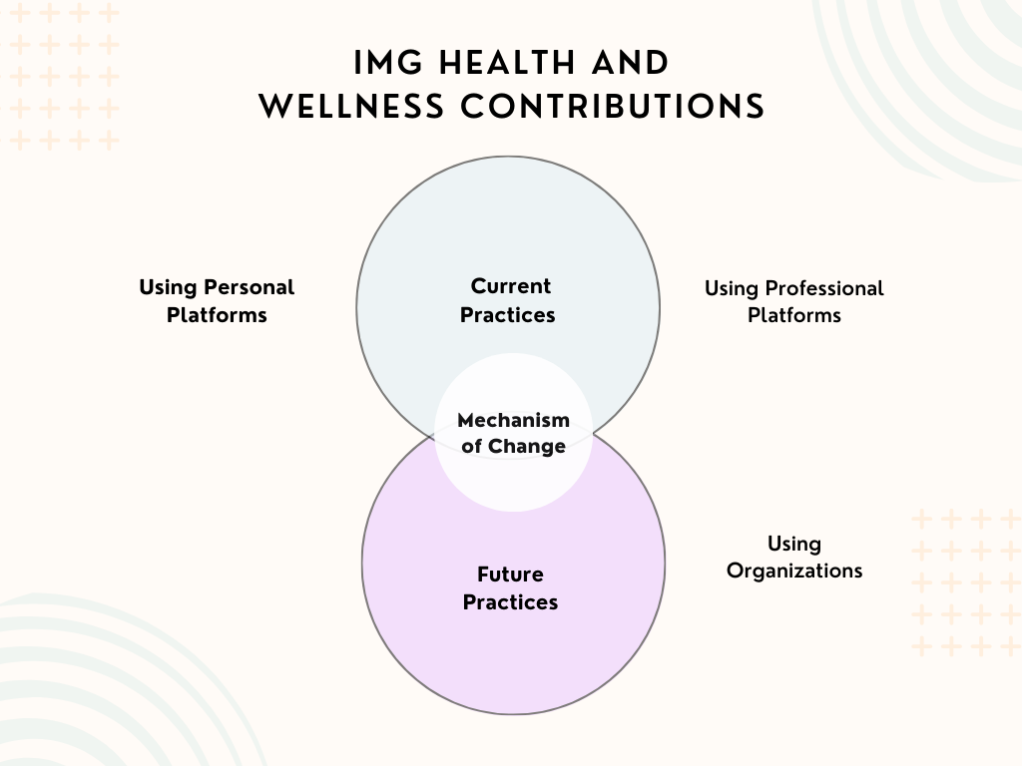
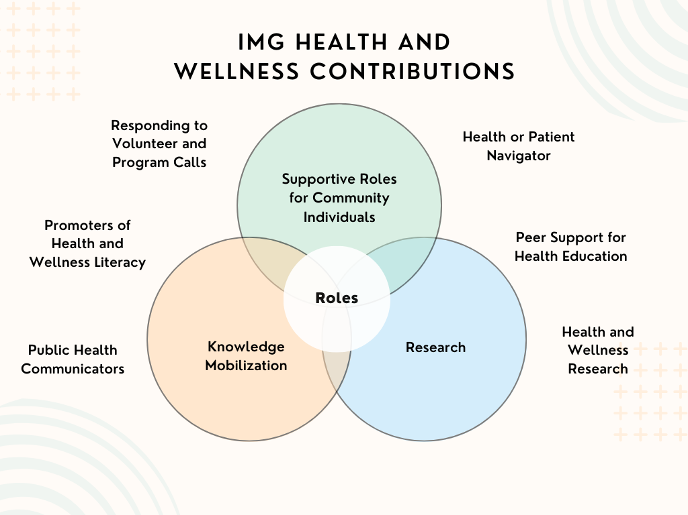
Contributions to Community Health and Wellness: An Exploratory Study on International Medical Graduates Pursuing Alternate Careers
Meriem Aroua^{1, 2}, Nashit Chowdhury ^{1, 2, 3}, Deidre Lake³, and Tanvir C Turin*^{1, 2}
1. Department of Family Medicine, Cumming School of Medicine, University of Calgary, Calgary, Alberta, Canada.
2. Department of Community Health Sciences, Cumming School of Medicine, University of Calgary, Calgary, Alberta, Canada.
3. Alberta International Medical Graduates Association
Objectives
Methods
Discussion
In primary care, challenges are exasperated due to:
an aging and diversifying population.
a growing burden of chronic diseases, and
a “shortage” of healthcare professionals.
With this backdrop, we explored contributions related to a readily available, yet “underutilized” group of health professionals - International Medical Graduates (IMGs) can potentially have in addressing these concerns in non-physician roles
Eight focus groups in total were conducted (n=42)
The focus groups were preformed over Zoom, thus allowing participation from across Canada
Inductive coding of the data followed by a thematic analysis was performed to synthesis results
Themes and sub-themes were reviewed and finalized following revisions with representative participants
The failure of recognizing credentials of migrant health workers, and not utilizing their skills and knowledge can contribute to the unsustainability of health systems in destination countries.¹
Community-based roles also require certain levels of community credibility and liaising to be impactful, which are skills that IMGs can and do possess.²
Future directions include large scale research on this topic, and critical analysis of the current Canadian job landscape.
We aimed to gauge this population in discussion to capture perspectives within the IMG community about contributions to health and wellness (CHW). Participants gave a range of alternative contribution pathways other than that of a physician practicing medicine, discussed varying levels of challenges, and on what levels can practice be modified. Many themes were then conceptualized from three big questions asked, which were regarding potential IMG roles, challenges, and mechanisms for change.
Conclusion
Findings indicate that IMGs possess many insightful suggestions and ideas surrounding contributions and community planning.
Organizations must know that IMGs are willing to fill many important roles in the community.
Figure 1. IMG Perceptions of CHW Challenges
Figure 2. IMG Perceptions of CHW Mechanisms of Change
Figure 3. IMG Perceptions of CHW Roles
References
Results
Strengths and Limitations
1. Ungureanu, M., Wiskow, C., & Santini, D. (2019). The future of work in the health sector. ILO Working Papers, Article 995016293502676. https://ideas.repec.org//p/ilo/ilowps/995016293502676.html
2. Feroz, A. S., Khoja, A., & Saleem, S. (2021). Equipping community health workers with digital tools for pandemic response in LMICs. Archives of Public Health, 79(1), 1. https://doi.org/10.1186/s13690-020-00513-z
IMGs are motivated to actively explore diverse roles for community health beyond medicine.
Proposed solutions involve cross-sectoral collaborative efforts, personal initiatives, and organizational resources including structure and support
IMGs can effectively and efficiently contribute to bridging cultural gaps and promoting health literacy.
Limitations include a Canadian-only sample size, since we were only interested in a Canadian context. Additionally, moderator and observation bias may play a role in study results as all focus-groups were joined by a moderator and note-taker.
Strengths include a participant-focused research approach, where participant voices and perspectives were used to answer the research question, and diverse perspectives accessed through focus group dynamics.
*Correspondence:
Dr. Tanvir C Turin
Department of Family Medicine, Cumming School of Medicine, University of Calgary, G012F,
Health Sciences Centre, 3330 Hospital Drive NW, Calgary, Alberta, Canada, T2N 4N1.
Tel: +1 403-210-7199, Fax: +1 403-270-4329
Email: turin.chowdhury@ucalgary.ca

