Slide 1
Belongingness of Newcomers Through Community Engagements: A Racialized Woman’s Experiences, Saskatoon, Canada
Oct 6, 2023
Dr. Jebunnessa Chapola SSHRC Postdoctoral Fellow
JSGS University of Regina, SK, Canada
&
Contract Faculty at Mount Royal University, Calgary, Canada
The Presentation is prepared for Mobilizing Knowledge on Newcomers Symposium

Slide 2
Reflections on lived Experiences Who Am I?
Cross-cultural Socialization
Interdisciplinary Education
Anti-racist Activities
Justice and Wellbeing Activities
Professional Activities
Taking responsibility for land and Environment
Becoming a Decolonial, Critical Anti-Racist Feminist and Relational Autoethnographic Researcher

Slide 3
Worldviews
Intersectionality
Hybridity
Otherness
Decolonization
Critical Anti-racist Theory and practice

Slide 4
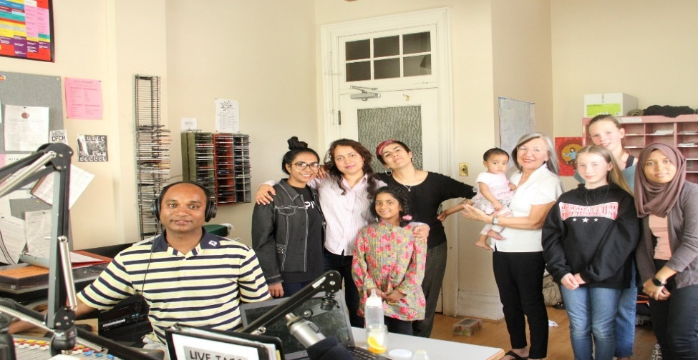
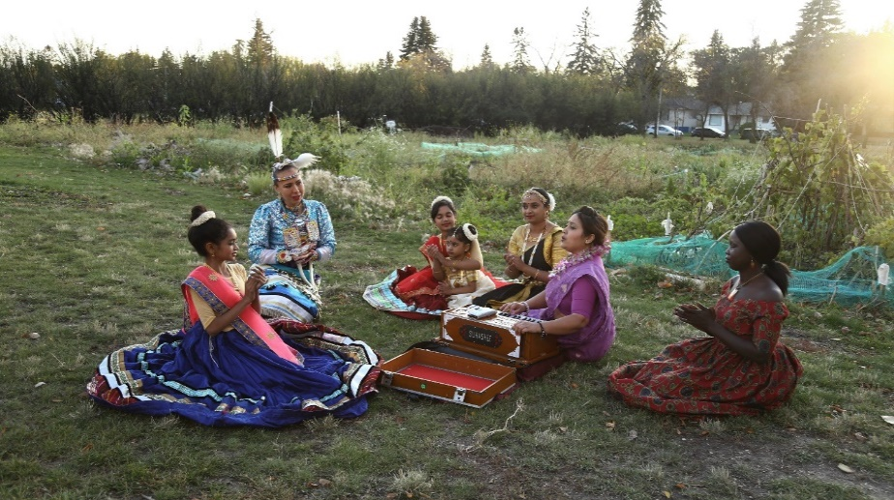
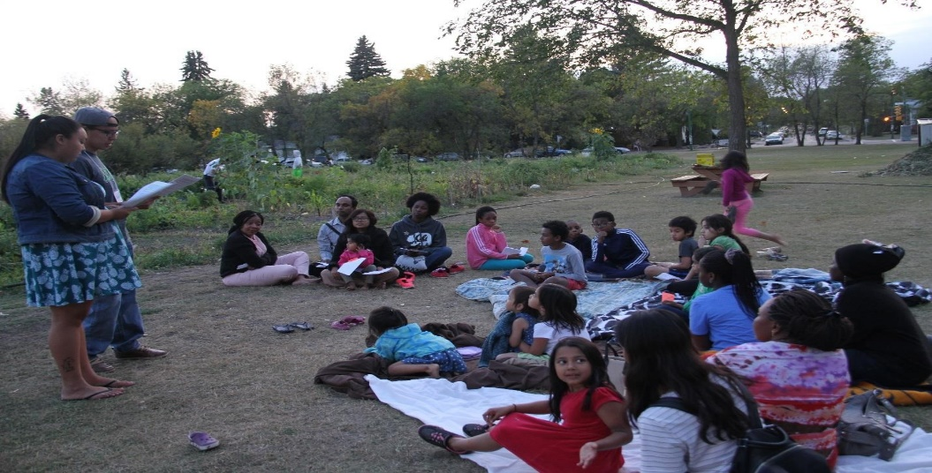
Methodologies and Methods
Decolonial and Anti-racist Feminist
Collaborative Community-Engaged Co-learning
Saskatoon Community Radio
Transnational Cultural Activities
Blanket Exercise in Community Garden

Slide 5
Decolonial Relational Auto-ethnography and Collaborative Co-Learning
Sharing each others histories and stories
Community radio conversation circles
Raising and taking care of each other’s children
Building community by maintaining relationships
Community gardening and food security
Connection with Indigenous Elders, knowledge keepers
Informal Anti-racist conversations
Sharing cultural activities (Dance, music, saree wrapping)
Making collaborative art with children & adults
Making quilts, knitting and sewing together

Slide 6
Co-learnings with Racialized Settler Women/ Artists

Slide 7
Our Community Garden and future generations: A story of a racialized woman, community builder/ activist

Slide 8
Why Community Garden?
Process of Community Building
Women’s Empowerment (Leadership, Gaining Knowledge etc.)
Open learning space
Environmental Education (Action for climate change)
Collective Work
Cross-cultural Sharing
Food Security
Fresh Organic food sources
Reduce dependency on market
Networking with BIPOC/ newcomers
Knowing the story of the food
Building bridges between Indigenous and non-Indigenous

Slide 9
Processes of Decolonization Through Blanket Exercise: Indigenous Elders, Youth and Knowledge-holders

Slide 10
With Indigenous Knowledge-holders: Land-based learnings in everyday practice

Slide 11
Relationality
Birds
Butterfly
Lady Bugs
Ants
Soil
Plants
Wind, Sky, Cloud, Rain
Human Beings

Slide 12
Learning Cree ( Indigenous Language)

Slide 13
Open and Informal learning spaces

Slide 14
BIPOC Children’s Art Activities

Slide 15
BIPOC Children’s Singing Time

Slide 16
Environmental Education for Racialized Children and Youth

Slide 17
Play with lady bugs, fruits and vegetables

Slide 18
Collective Ways of knowing

Slide 19
Collective Work for the Community Garden (Children’s Plot)

Slide 20
Cross-cultural Sharing

Slide 21
Music, Dance, Story Telling with Mothers/ Families

Slide 22
Advocating for Artists of Colour and Student Mothers

Slide 23
Food Sharing and Food Sovereignty

Slide 24
Food Nutrition and Mother’s Sharing Circle

Slide 25
Networking to Grow Together

Slide 26
Together Building a Community

Slide 27
Meaning of the Land to a Racialized Woman

Slide 28
Learnings from the Land
The Land is Mother, Teacher and Healer
The Community Garden Land is a Classroom
The Land Provides a Curriculum for Teaching
The Land Creates Community Solidarity
The Land Teaches the Meanings of Decolonization and Reconciliation

Slide 29
Source of Doctoral Dissertation
Ph.D. dissertation link: https://harvest.usask.ca/handle/10388/14135
Usask Featured the Research Story:
https://news.usask.ca/articles/colleges/2022/a-new-canadians-path-to-reconciliation.php
Interviewed by the Multicultural Council of Saskatchewan (Mcos)
https://mcos.ca/blog/dr-jebunnessa-chapola/
University of Regina Postdoc profile and Publication list:
Jebunnessa Chapola - Graduate School of Public Policy

Slide 30
Community Recognitions
Reflections myWWho self as ResearcMy Responsibilities
International Association of Maternal Action and Scholarship Student Changemaker Award 2023
Anti-racist Champion (Provincial Award), Multicultural Council of Saskatchewan, 2015
CBC Future 40 Award, Saskatchewan, Canada 2015
Excellence in Community Services, GSA, U of S, 2016
BBC Bangla listed as 100 Inspirational Women, 2016
YWCA Women of Distinction, Community Building (Nominated), 2016
CFCR Community Radio Volunteer, Saskatoon, SK, Canada, 2014
Beyond Trailblazer, Multicultural Council of Saskatchewan, 2014

Slide 31
Contacts
Dr. Jebunnessa Chapola (Pronoun: She/her) SSHRC Postdoctoral Fellow
Johnson Shoyama Graduate School of Public Policy,University of Regina, SK, Canada
Sessional Lecturer, General Education
Mount Royal University, AB, Canada
E-mail: jchapola@mtroyal.ca

Slide 32
Thanks and Questions

