Slide 1
Immigration Partnership Saskatoon
ipsk.ca

Slide 2
Who we are
One of many Local Immigration Partnerships (LIPs)
Working together to facilitate the successful settlement and integration of newcomers to Saskatoon
Multi-sectoral partnership
Partnership Council
Immigrant Advisory Table
Working Groups
Hosted by City of Saskatoon

Slide 3
Goal of research
To understand challenges internationally-trained and experienced immigrants face during the registration, certification and licensing processes when trying to find work in their fields.

Slide 4
IPSK Research
Internationally-trained and experienced immigrants seeking employment were interviewed
Regulatory bodies were interviewed
The need for Canadian Experience was frequently highlighted as a barrier
This is contrary to the admissions process where they successfully gain admittance to Canada through the NOC code system where they receive points for training, credentials and experience.

Slide 5
What they said:
Receive inconsistent information from various sources
Need to filter through multiple, sometimes competing information sources
Need for clarity and direction about which regulatory body to contact and what steps to follow

Slide 6
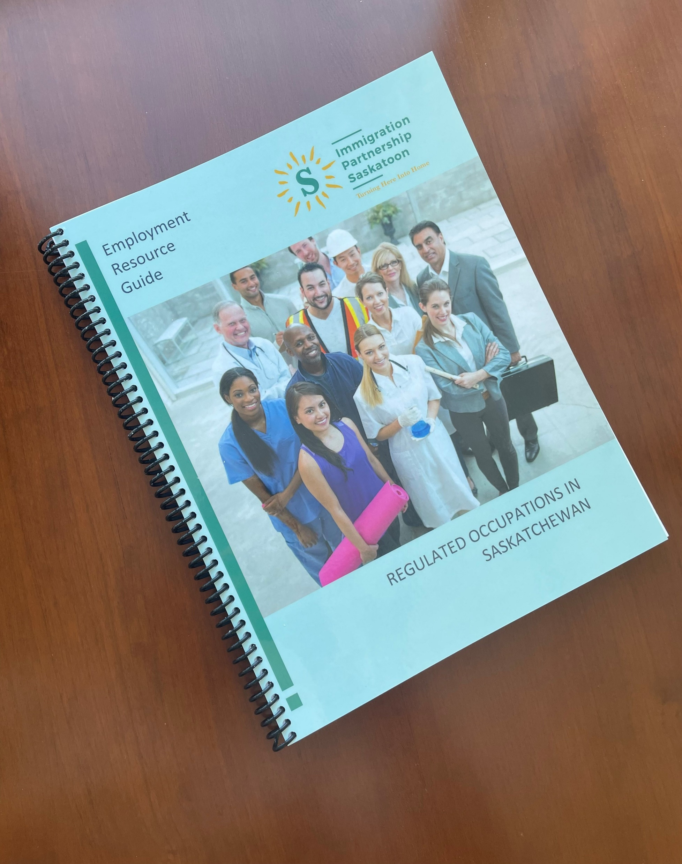
Launch of Employment Resource Guide

Slide 7
Legislative Angle

Slide 8
Ontario Legislature Bill 88: Working for Workers Act
Received Royal Assent in April 2022
States that the term Canadian Experience can no longer be used in the regulated professions
Resulted from an Ontario Human Rights Commission ruling that the term Canadian Experience was discriminatory

Slide 9
Bill 81 Saskatchewan- Labour Mobility and Fair Registration Practices Act
Received Royal Assent in May 2022
States that:
regulatory bodies shall not require internationally-trained applicants to complete additional training, experience, examinations, or assessments in areas where they have already demonstrated competence
Met with Deputy Minster Repski of Immigration and Career Training – excited and want to be among provinces leading the way

Slide 10
Bill C-286: Federal Bill
States that federal and provincial ministries can work together to create regulations that equate international educational credentials with Canadian ones
Implications for federally-regulated professions such as Telecommunications
Met with MP Redekopp who authored the bill and he is considering adding the language about NOT requiring Canadian experience

Slide 11
Future Implications of Research
These observations pose the question, Are employer/regulator requirements of Canadian-based education, training, experience, and professional eligibility a way of excluding immigrants from opportunities appropriate to their qualifications gained abroad?
This research should be done in partnership with agencies such as LIPs and Settlement Agencies

Slide 12
Future Avenues for Research
What is the actual difference between Canadian and non-Canadian qualifications and experience?
- E.g. Recreation Therapy, Accounting
Data on immigrants – How many are working in their fields vs. How many aren’t working in their fields & Why
- Data from Ministries, Employers, Immigrants
What is the role of Post-Secondary institutions in operating bridging programs?
- Which programs are successful?
What is the role of Ethnocultural groups – Can they be a facilitating agency or stakeholder for implementation?

