Slide 1
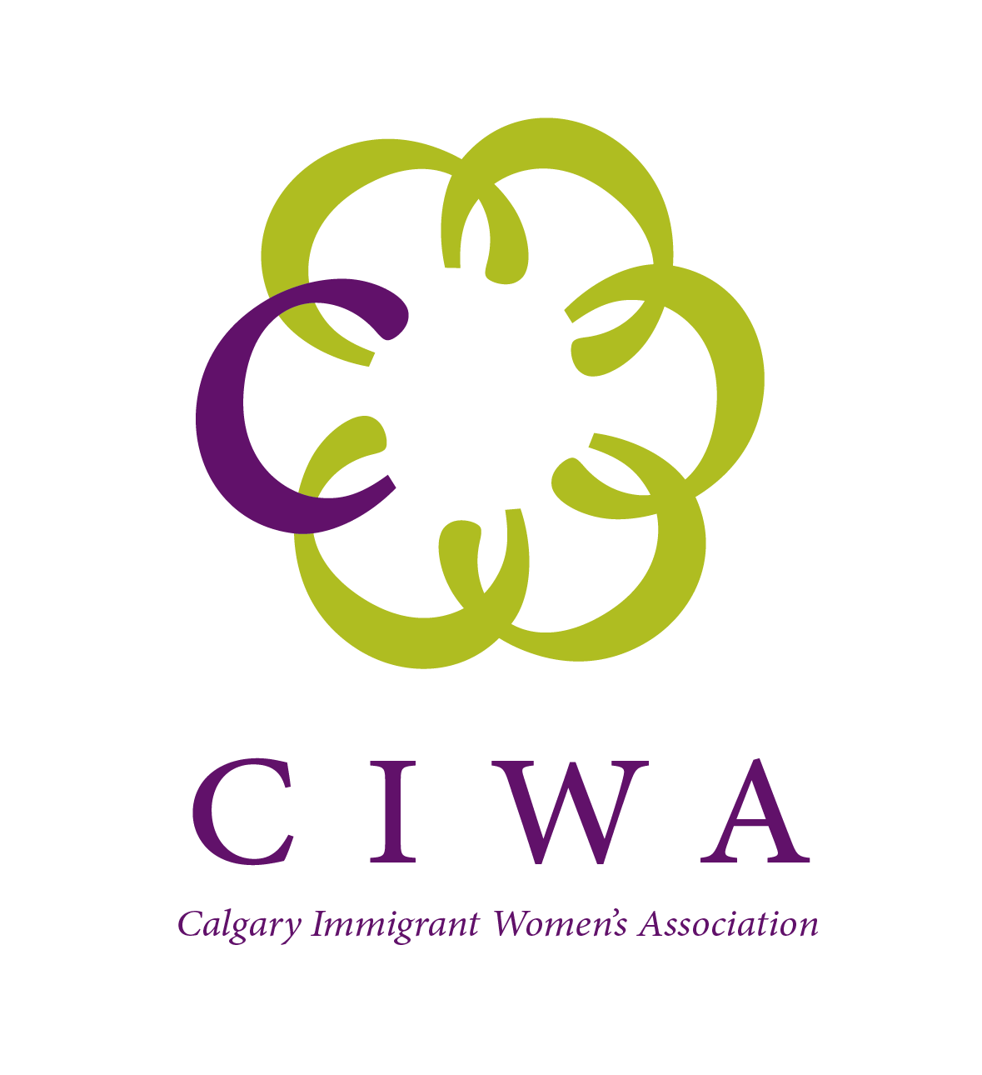
Mobilizing Knowledge on Newcomers Symposium
The Best Western Premier Calgary Plaza Hotel and Conference Centre 1316 33 Street NE Calgary, AB October 6, 2023
Mindfulness for Social Recovery and Wellbeing of Immigrant Women
Presenter: Ivana Calina
Calgary Immigrant Women’s Association

Slide 2
Calgary Immigrant Women’s Association – Our Mandate
Vision
Empower immigrant women. Enrich Canadian society.
Mission
National leader in transitioning immigrant women to success in Canada.
Values
Equity. Excellence. Collaboration. Inclusiveness. Empowerment.
Notes:
A brief introduction about CIWA: it is the largest gender specific immigrant serving agency in Canada

Slide 3
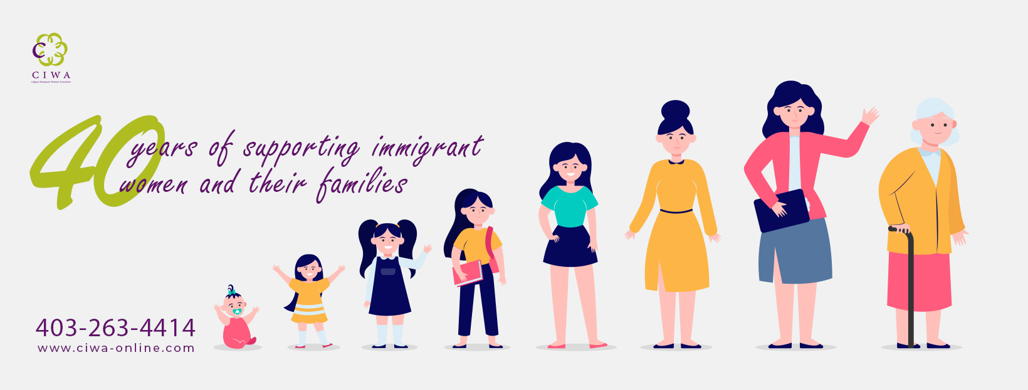
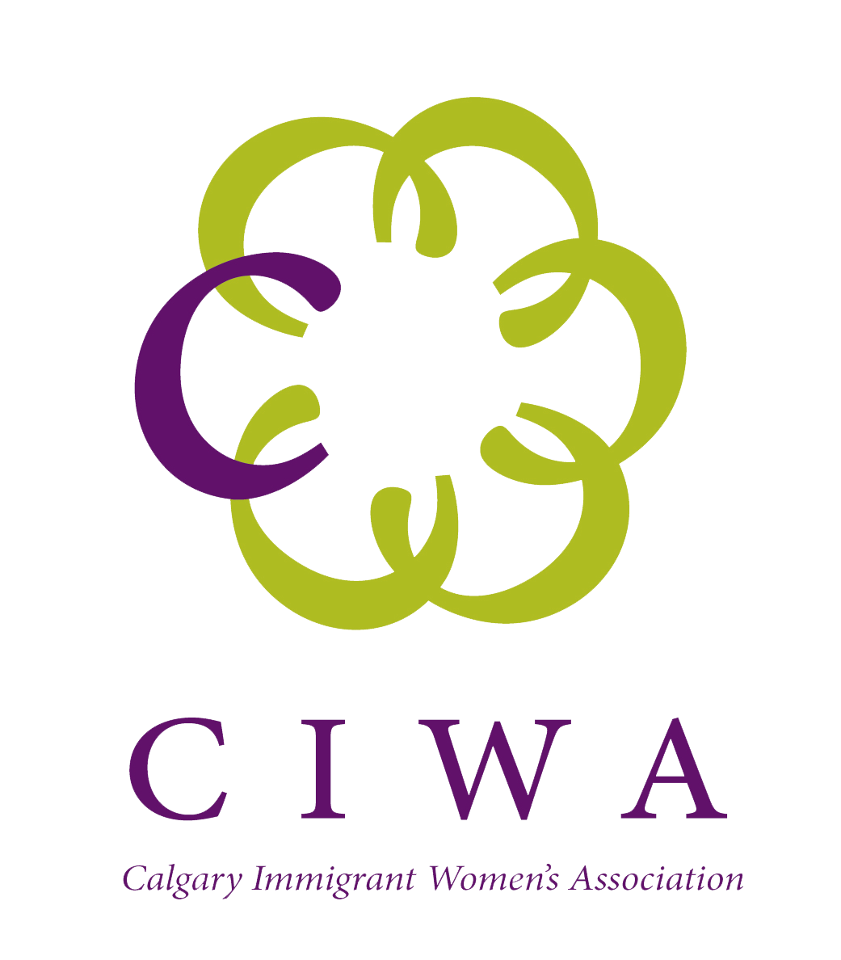
Calgary Immigrant Women’s Association – About Us
Calgary Immigrant Women's Association (CIWA) is a non-profit organization established in 1982 as a registered charity. CIWA is a culturally diverse settlement agency that recognizes, responds to, and focuses on the unique concerns and needs of immigrant and refugee women, girls, and their families.
CIWA’s uniqueness is based on its gender specific mandate. Over the years, we have continually responded to emerging needs of immigrant women and girls, developed innovative programs, established meaningful partnerships, and have come to be recognized as a provincial and national leader in outcome-based gender-specific settlement services.
Notes:
Some fast facts to situate our agency and experience:
- we offer wrap around services for immigrant women and their families
- notable strengths are supports available for those who experience gender based violence and
- many opportunities to attach to the labour market

Slide 4
Social Recovery and Wellness of Immigrant Women Project
Commenced in June 2022 to support the social recovery of vulnerable immigrant women, impacted by family violence and/or poor mental health as a result of the pandemic.

Slide 5
PD Training for CIWA staff
Mindfulness Based Cognitive Therapy provided for 10 CIWA staff by the project partner

Slide 6
Customized curriculum developed that teaches mindfulness attitudes and practices to promote mental health and well-being among vulnerable populations
8 week long Mindfulness training workshop series for immigrant women
Weekly handouts to encourage practice at home
Certificates awarded at the end of the program
Post-surveys completed 3 and 6 months after the program completion

Slide 7
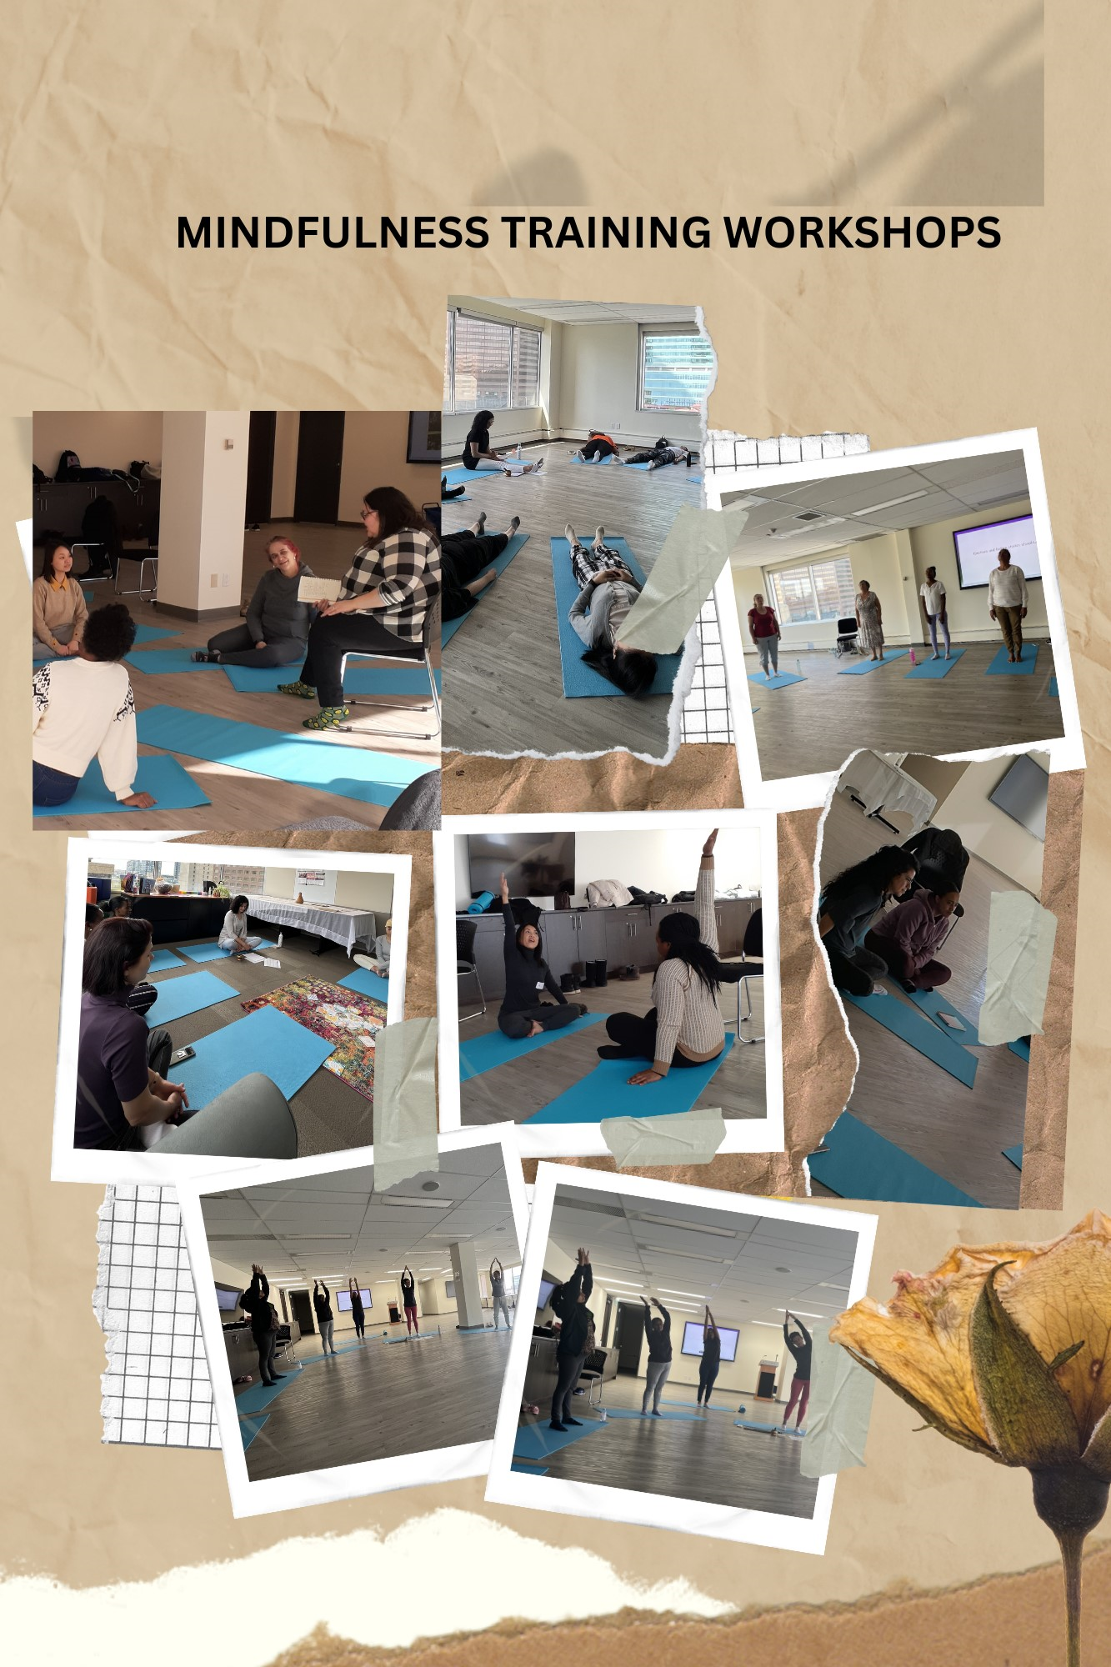
Notes:
8-week long Mindfulness Training Workshop Series curriculum developed based on the feedback from the focus groups and in collaboration with the Alberta Mindfulness Association.

Slide 8
An innovative service delivery model utilizing technology
https://youtu.be/BgfSLWijcrY

Slide 9
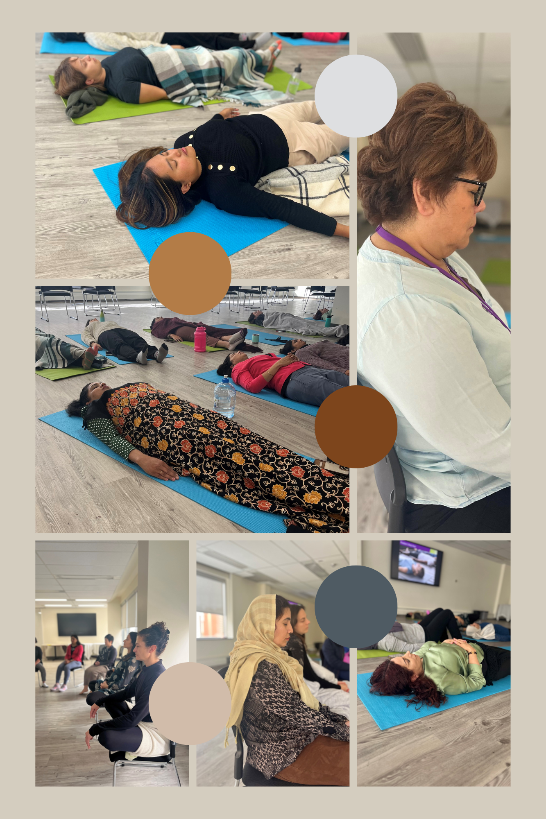
Mindfulness Training for Service Providers
Conducted with our sister agency-CAIWA in Red Deer that brought 11 front line service providers together to learn and apply mindfulness approach to enhance programs and services
Provided for the CIWA Family Services Department 23 staff members
Two more trainings scheduled to be delivered in October

Slide 10
Customized curriculum for family members
20 spouses and other family members (youth, grandparents) engaged in the development of customized curriculum
1 customized curriculum developed based on needs assessment and feedback from spouses/perpetrators of immigrant women impacted by gender-based violence

Slide 11
OUTCOMES
SHORT TERM | MID TERM | LONG TERM
Civil society organizations learn innovative approaches to support the social recovery and wellbeing of immigrant women Vulnerable populations learn strategies to cope with future stressors that may arise after the pandemic | Civil society organizations have increased capacity to develop and implement innovative approaches to the delivery of programs and services. Vulnerable populations have the strategies to cope with future stressors that may arise after the pandemic | Immigrant women are empowered to engage in the community

Slide 12
Alberta Community and Social Services
OUR FUNDERS

Slide 13
Questions?
Social Recovery and Wellness of Immigrant Women
CIWA-Family Services Department-7th floor
#200,138 4 Ave SE, Calgary, Alberta
Ivana Calina
IvanaC@ciwa-online.com | 1-403-263-4414 ext. 289 | www.ciwa-online.com
Calgary Immigrant Women’s Association
@ciwayyc
@ciwayouthzone
@ciwa_yyc
@ciwayouthyyc
@ciwa_yyc

