Slide 1
Place-Based Trauma and Recovery: Navigating Emotional Landscapes Amidst Sudden Environmental Shifts
Lessons Learned from Urban Refugees
Tugba Altin

Slide 2
Table of Content
Background
Literature Review
Research Questions
Methods and Co-researchers
Preliminary findings

Slide 3
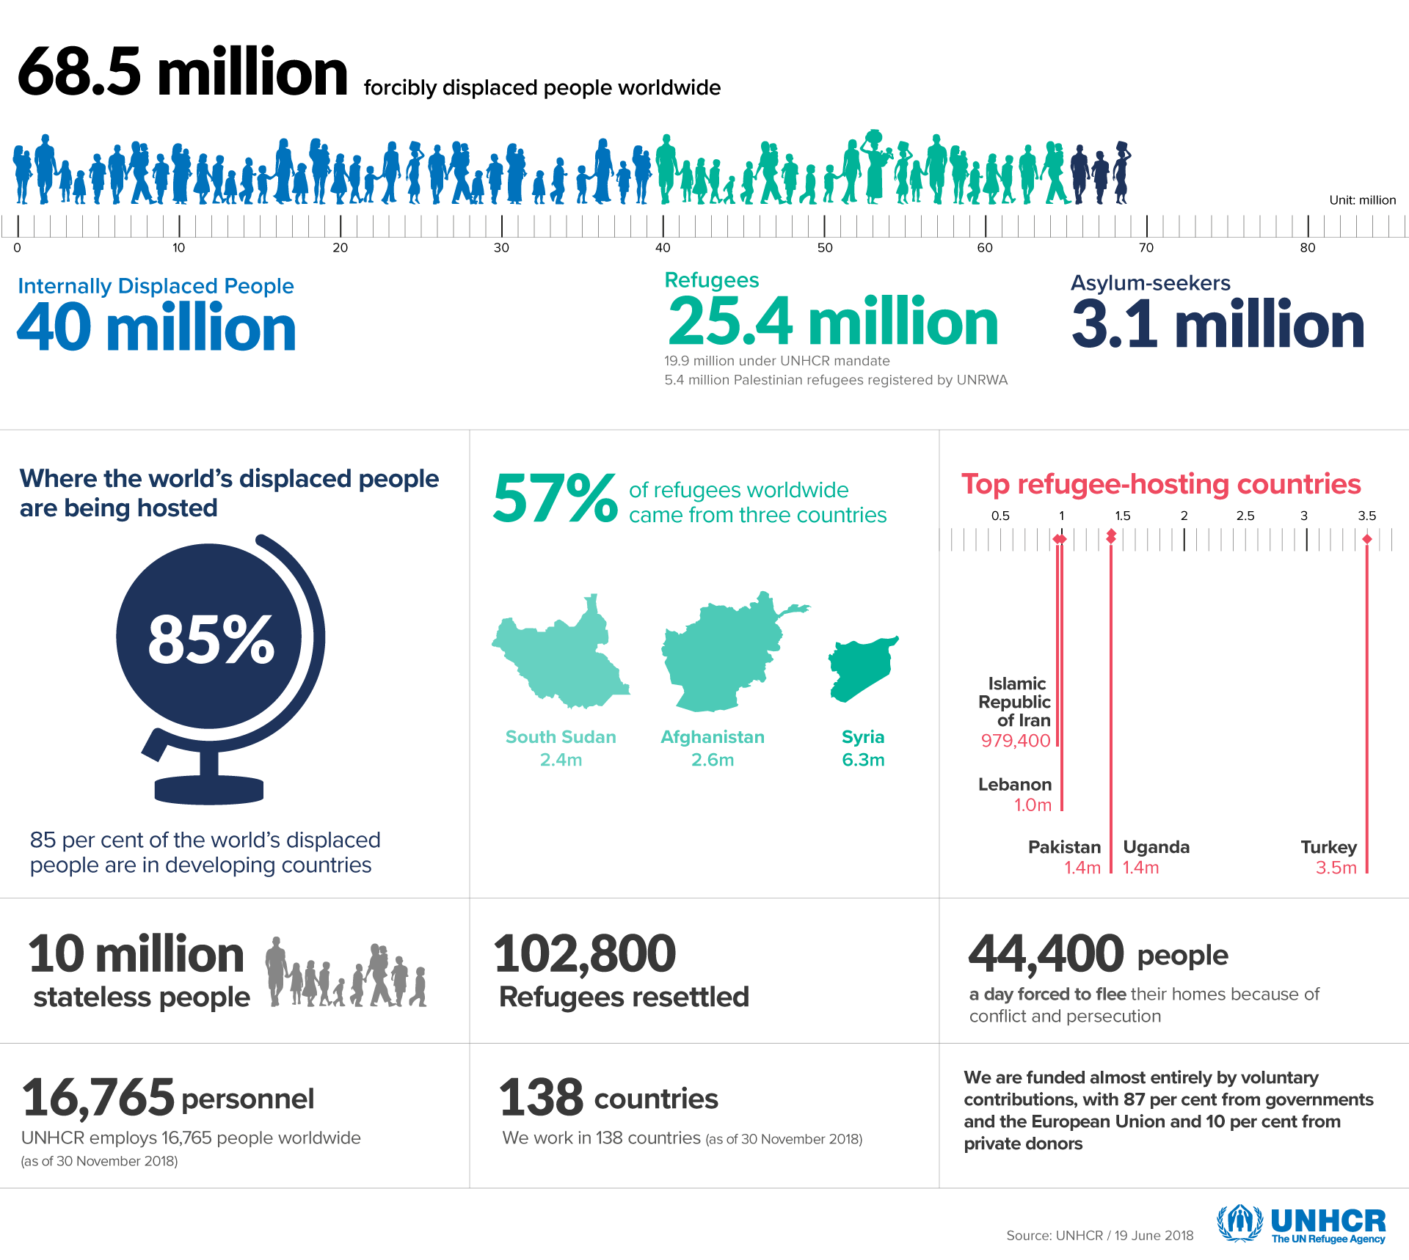
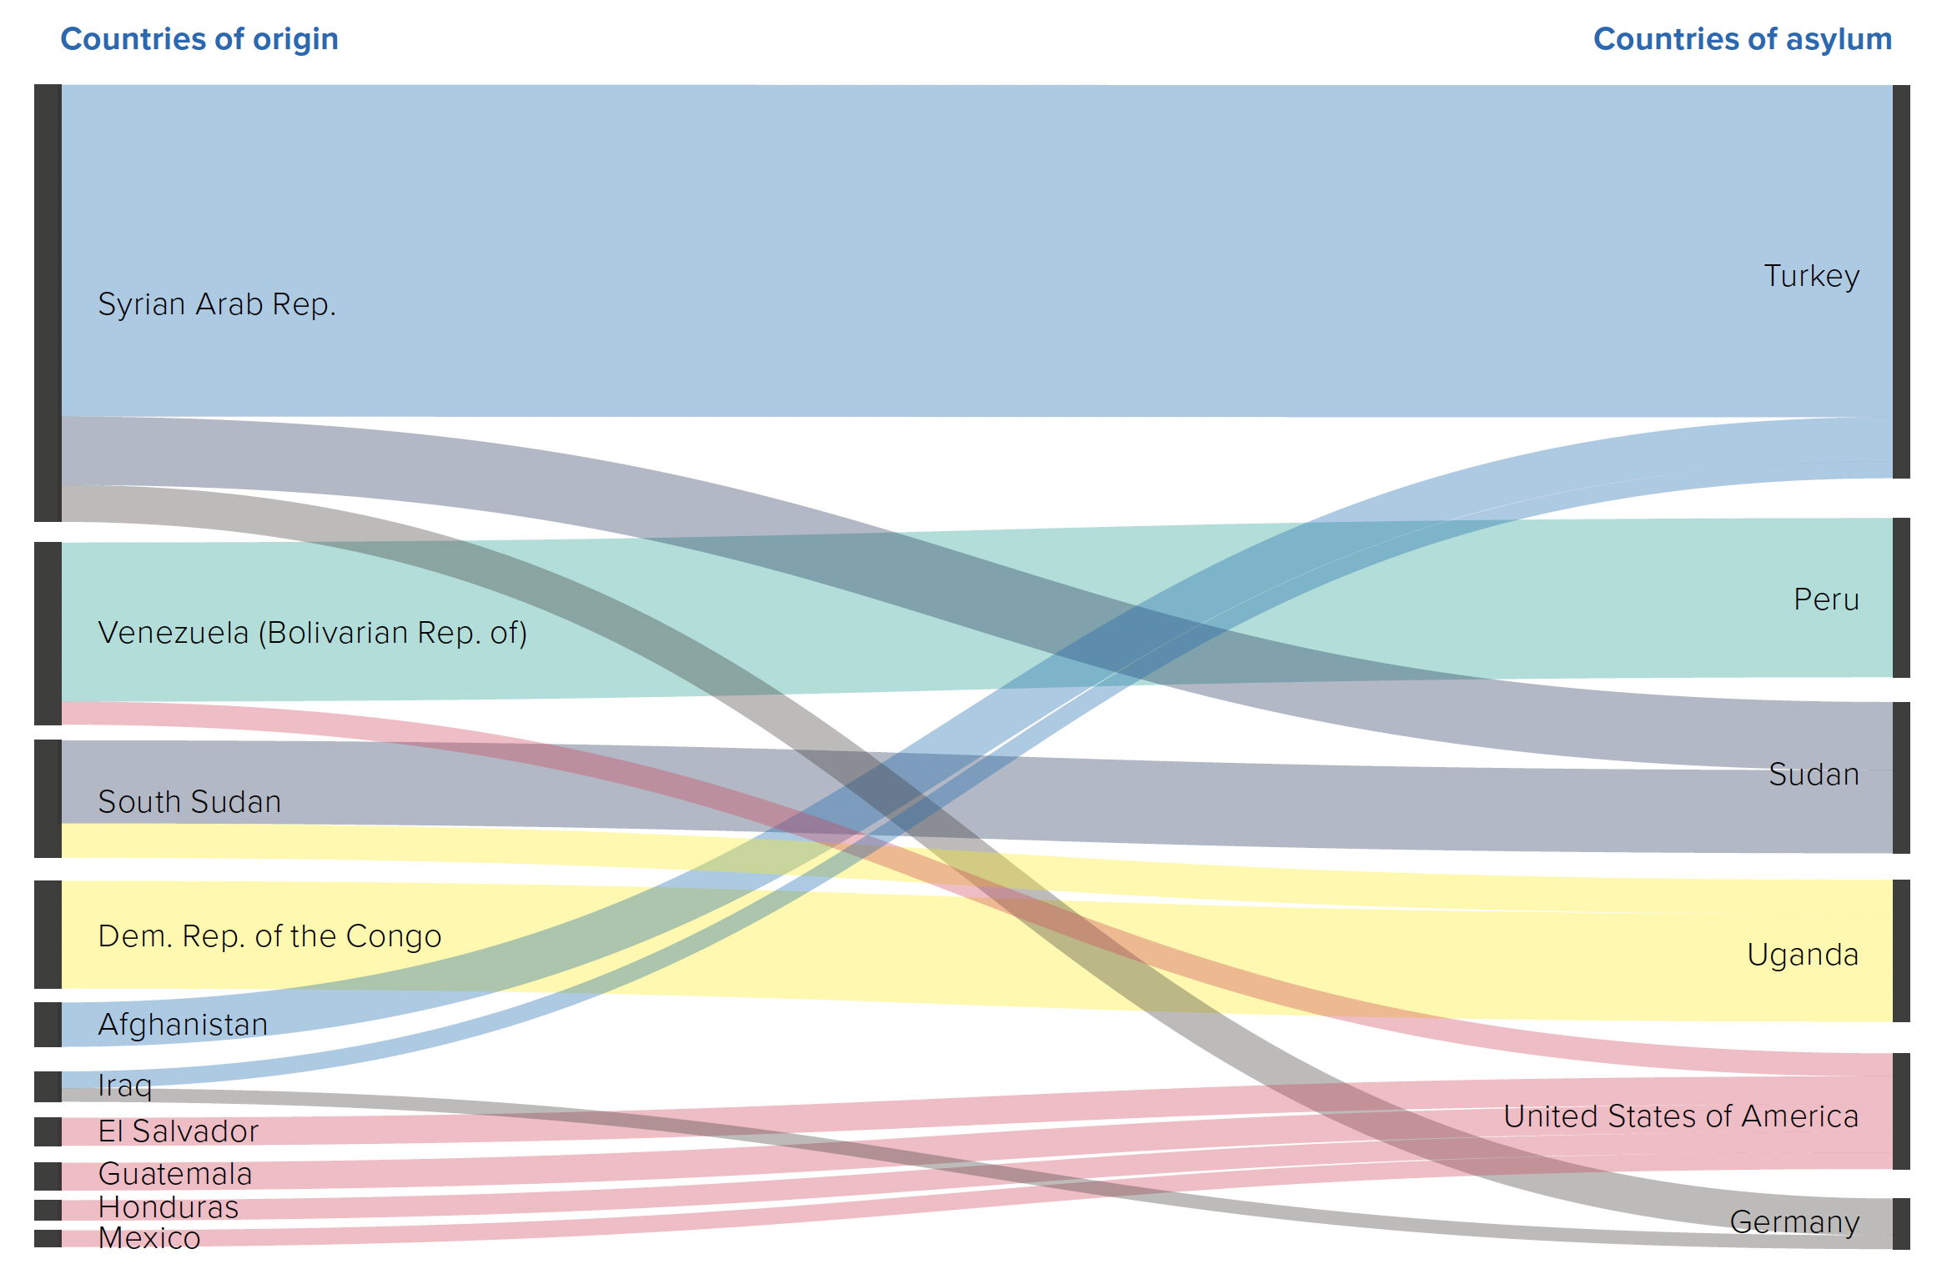
Global Trends in Forced Displacement in 2018
Notes:
This chart is prepared by United Nations High Commissioner for refugees

Slide 4
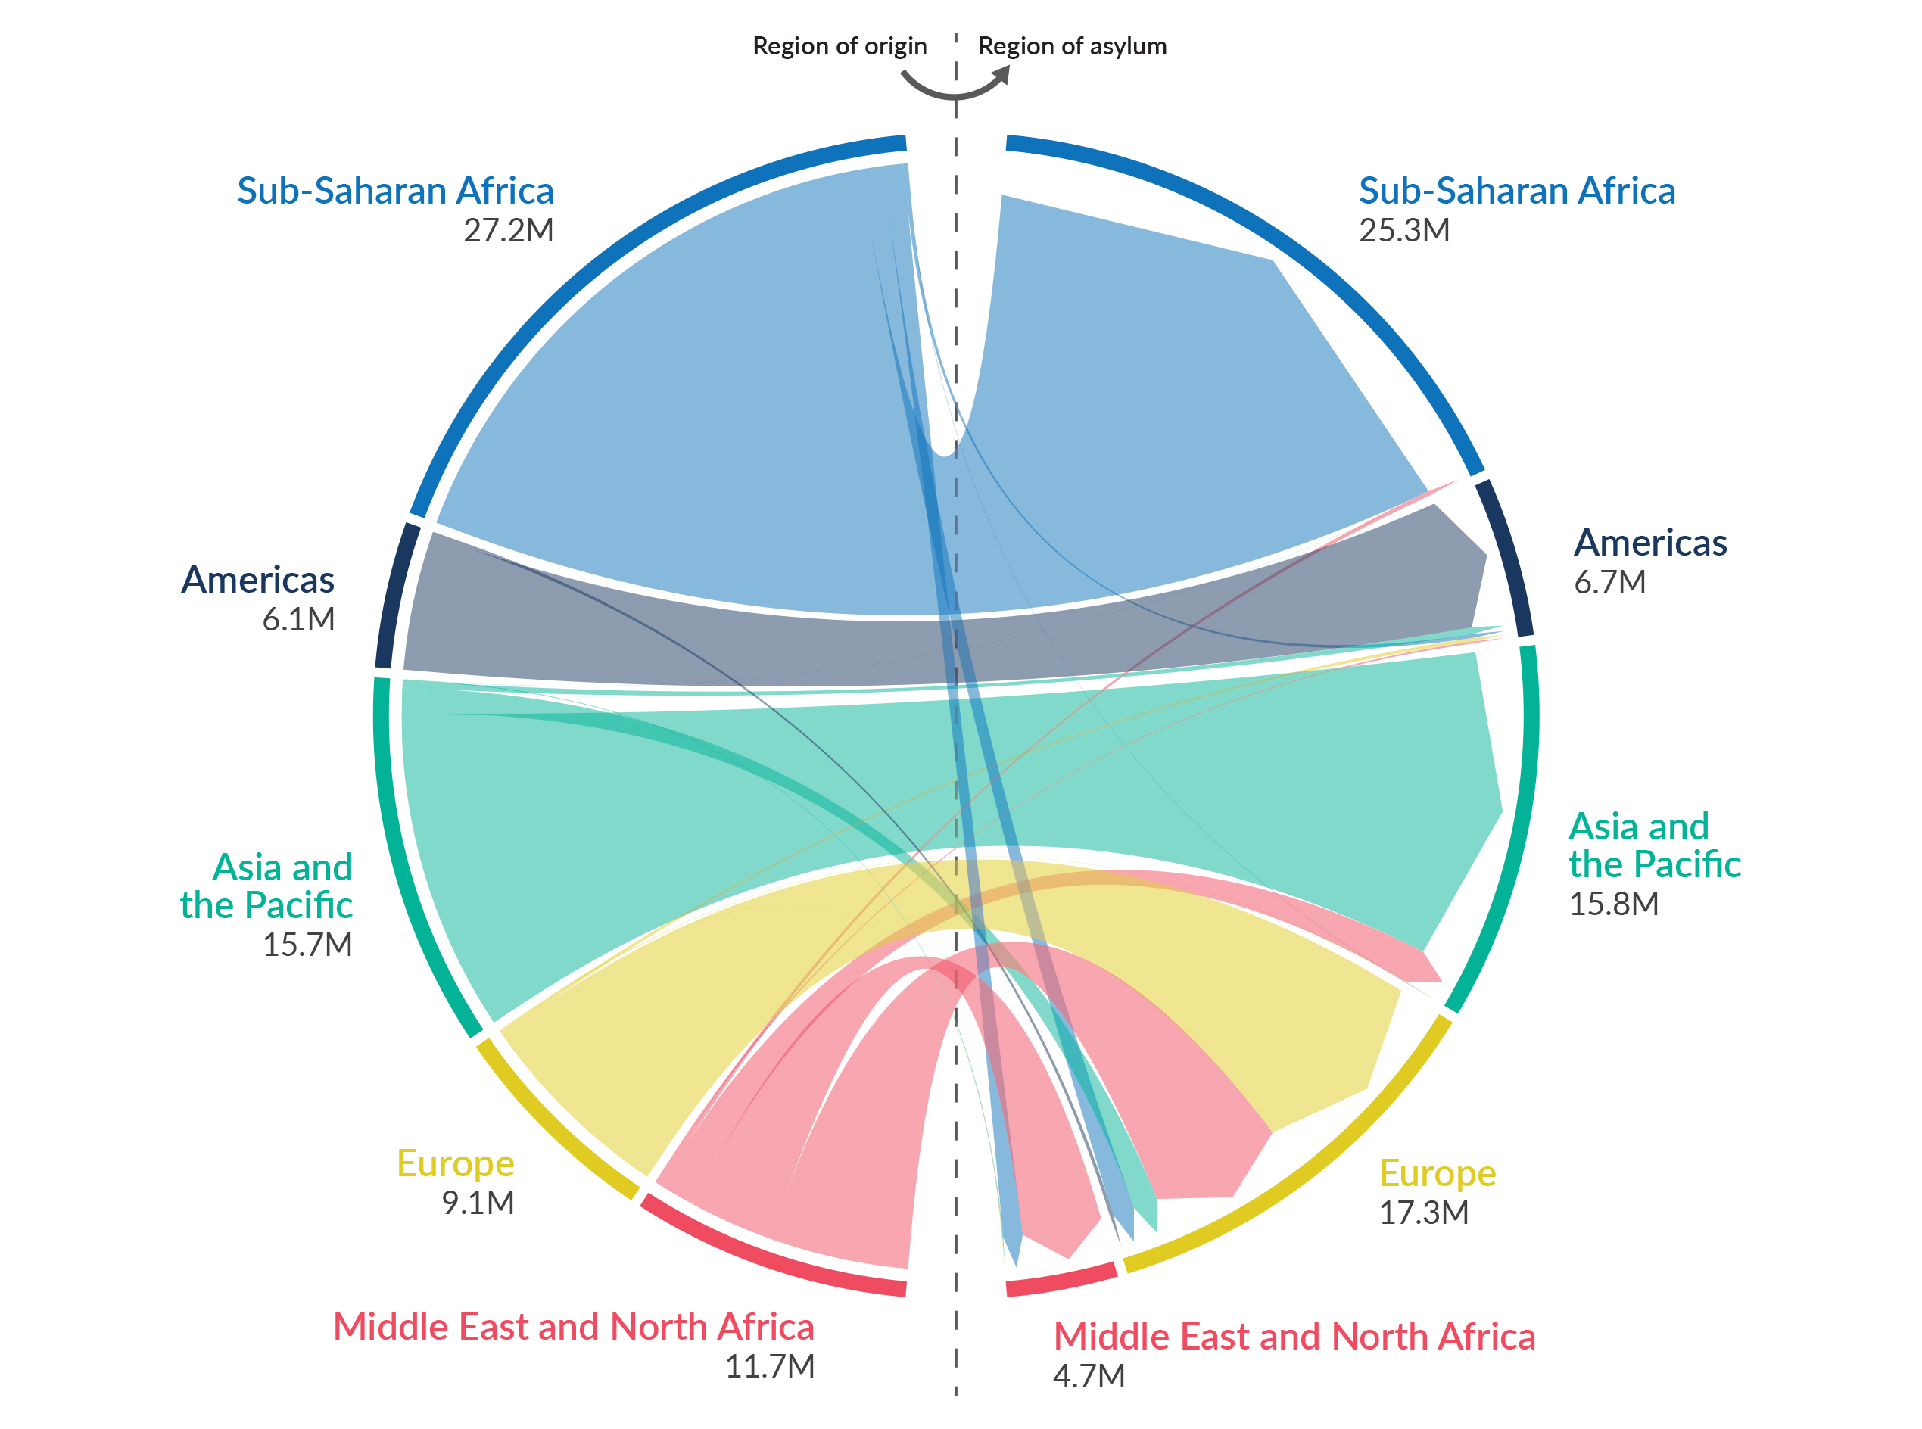
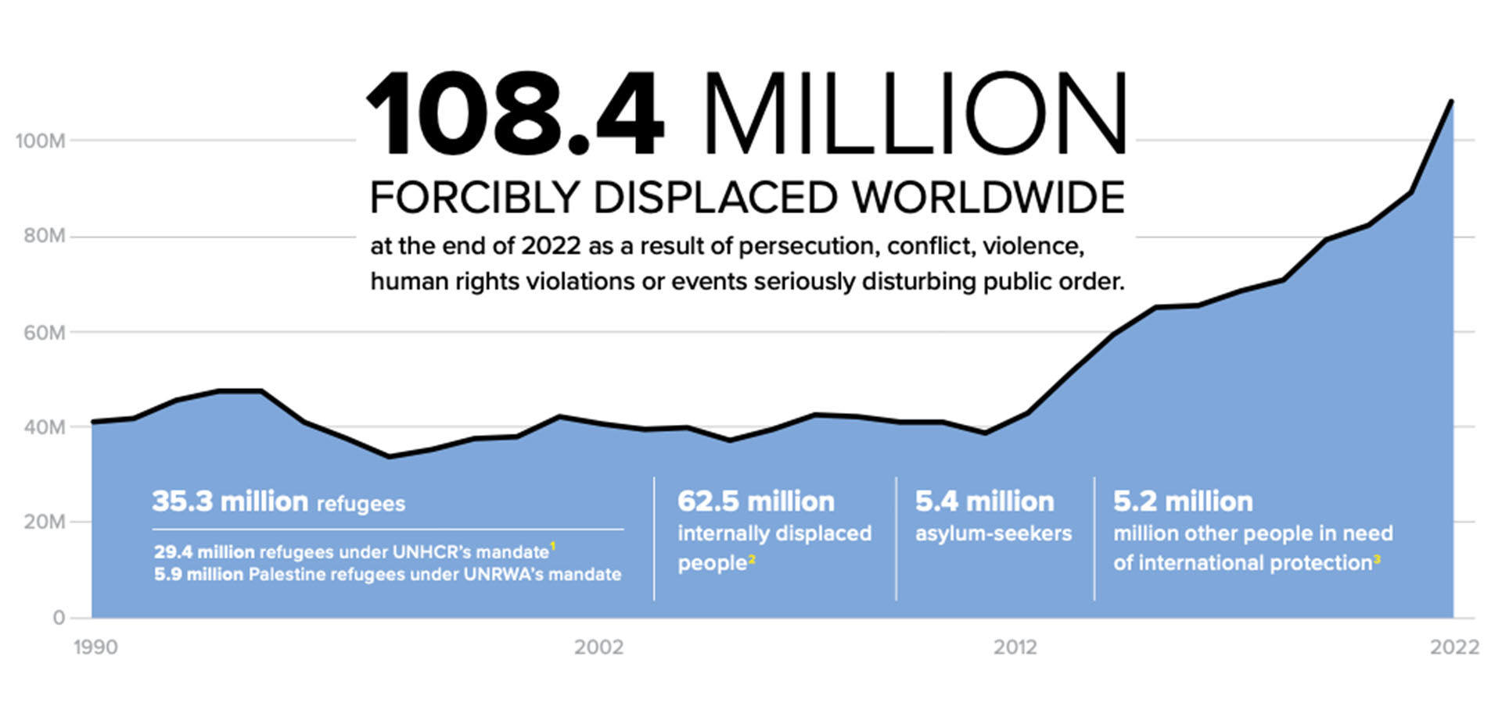
Global Trends in Forced Displacement in 2022
Notes:
These charts are significant as they show whereabouts of the displaced people. According to the UNHCR 70% of the displaced people are hosted in neighboring countries that are mostly considered low and middle income countries

Slide 5
Why it matters?
Significant increase in the number of people who experience displacement
Accessibility to secure living conditions and safety
Social cohesion
Long term solutions
Wellbeing and recovery
Settlement
Integration through language
Access to job market
Access to healthcare
Acknowledging trauma
Access to mental health and well-being
Coping and resilience
Cross-cultural conversation
Notes:
Why it matters? Because the number of people who are forcibly displaced or stateless are increasing drastically. While the numbers were close to 70 million people in 2018, today UNHCR estimates almost 120 million people are facing with forced displacement which shows almost 42% increase in the number of people who experience forced displacement just in 5 years cial Cohesion: Forced displacement often disrupts social structures and can lead to tensions between displaced populations and host communities. Open dialogue can promote understanding, integration, and social cohesion. Long term solutions mostly address settlement, access to job and opportunities, legal status that address their citizenship in the arrival country. Wellbeing and recovery on the other hand, mostly overlooked.

Slide 6
How do Forced Displacement and Place Attachment (PA) Literatures Approach to the Subject?
Literature Background
The loss of home as a result of sudden change in place lead to traumatic reactions; stress, depression, grief, or emotional disorientation
The loss and after-effects of the loss influence how the place is experienced and people’s feelings of place attachment
Recovery happens when:
People mimic their lost home landscape
Transfer their place-based experiences by bridging similarities between pre- and post-change landscape
Landscape help people recover their place attachment as the landscape provides:
Sense of familiarity
Solace
Evokes positive associations and memories (Bowler, Buyung-Ali, Knight, & Pullin, 2010)
Notes:
Here the key literatures that are referred to are as follows: Urban studies, cultural geography, and cultural landscape; urban refugee literature, and attachment theory

Slide 7
Research Problem
Place-based changes are increasing, and action plans address only the tangible impacts of the events
Action plans overlook people’s relationship with the places and what meanings the places hold for them
Long term solutions fail as most of overlook addressing trauma associated with displacement
Delay in recovery both tangibly and intangibly
Notes:
z

Slide 8
What happens when solace disappears? How do people recover then?
Notes:
With this question in mind, this research aims to understand and address forcibly displaced peoples’ own narratives in understanding the significance of specific given urban spaces (religious, public, private, etc)? How do utilization and understanding of these urban landscapes help us understand what recovery looks like for forcibly displaced people?

Slide 9
Urban Landscapes, Place Attachment, and Recovery
People lose access to their everyday urban landscape and forced to adapt an unfamiliar urban landscape
Traumatic exposure to the stressor as they lack access to familiar landscape
Psychoterratic illness when people’s wellbeing is threatened by the severing of healthy links between themselves and their home landscape (Albrecht et al., 2007)
Longing
Homesickness
Trauma response
People’s place-based experiences and their perceptions on the place change
Shape people’s PA experiences and recovery processes in the arrival destinations
How do cultural landscapes within urban environments influence the development of place attachment and a sense of home among forcibly displaced individuals, and what are the key factors and mechanisms involved in this process?
How does access to cultural landmarks, social support networks, and familiar spaces within urban landscapes contribute to the psychological well-being and resilience of forcibly displaced people, and how do these factors interact with their sense of place attachment and feeling at home?

Slide 10
Methods
Co-researchers
Observations & field notes;
Semi-structured interviews;
Audiotape;
Transcription;
Theme analysis
Forcibly displaced families;
War-induced displaced families from Syria in Paterson and Elizabeth, New Jersey USA
Political-induced displaced families from Turkish in Kingston, Ontario Canada
Mosque members administrator;
Business owners in the neighborhoods
Community members

Slide 11
Preliminary Results and Future Directions
Resettlement agencies fail addressing newly arrived communities’ wellbeing recovery processes
Segregated settlement disrupts and delays communities’ belonging in their new urban landscape that adds another layer to isolation from the urban environment
High dependency on previously arrived communities
Lack of encounter with the already existing communities due to inaccessibility to urban landscape
Cultural landscapes such as mosques, community centers, and bodegas are encounter nodes of connection and interaction
Urban parks and public spaces are crucial in supporting the communities’ recovery
Sense of familiarity
Sense of place
Sense of belonging

Slide 12
Thank you!

Slide 13
References
Adams, H., & Adger, W. N. (2013). The contribution of ecosystem services to place utility as a determinant of migration decision-making. Environmental Research Letters, 8(1), 1-6.
Adams, H. (2016). Why populations persist: mobility, place attachment and climate change. Population and Environment, 37(4), 429-448.
Adger, W., Arnell, N. W., Black, R., Dercon, S., Geddes, A., & Thomas, D. S. G. (2015). Focus on environmental risks and migration: causes and consequences. Environmental Research Letters, 10(6), 1-6.
Altman, I. & Low, S. M. (1992). Place Attachment. New York, NY: Plenum
Anton, C. E., & Lawrence, C. (2014). Home is where the heart is: The effect of place of residence on place attachment and community participation. Journal of Environmental Psychology, 40, 451-461.
Boğaç, C. (2009). Place attachment in a foreign settlement. Journal of environmental psychology, 29(2), 267-278.
Brehm, J. M., Eisenhauer, B. W., & Stedman, R. C. (2013). Environmental concern: examining the role of place meaning and place attachment. Society & Natural Resources, 26(5), 522-538.
Briggs, L., Stedman, R., & Krasny, M. (2019). Place attachment and social–ecological system sustainability examined through the voices of indigenous Guatemalan women. Sustainability Science, 14(3), 655-667.
Brown, G., Raymond, C. M., & Corcoran, J. (2015). Mapping and measuring place attachment. Applied Geography, 57, 42-53.
Collier, D. & Mahoney, J. (1996). Insights and pitfalls: Selection bias in qualitative research. World Politics, 49(1), 56-91.
Cross, J. E. (2015). Processes of place attachment: An interactional framework. Symbolic Interaction, 38(4), 493-520.
Draucker, C.B., Martsolf, D.S., Ross, R., & Rusk, T.B. (2007). Theoretical sampling and category development in Grounded Theory. Qualitative Health Research, 17, 1137-1148.
Fullilove, M. T. (1996). Psychiatric implications of displacement: Contributions from the psychology of place. American Journal of Psychiatry, 153(12), 1516-1523
Harper, D. 2012. Visual Sociology. New York, New York: Routledge.
Hidalgo, M. C., & Hernandez, B. (2001). Place attachment: Conceptual and empirical questions. Journal of environmental psychology, 21(3), 273-281.
Johnson, M. (2007). The meaning of the body. Aesthetics of human understanding. Chicago: The University of Chicago Press.
Lewicka, M. (2011). Place attachment: How far have we come in the last 40 years?. Journal of environmental psychology, 31(3), 207-230.
Marcus, C. C. (1992). Environmental memories. In I. Altman & S. M. Low (Eds.), Human Behavior and Environment: Advances in Theory and Research (pp. 87-112). New York: Plenum Press.
Mason, J. (2002). Qualitative researching, 2nd Edition. London: Sage.
Morgan, P. (2010). Towards a developmental theory of place attachment. Journal of environmental psychology, 30(1), 11-22.
Nicolosi, E., & Corbett, J. B. (2018). Engagement with climate change and the environment: a review of the role of relationships to place. Local Environment, 23(1), 77-99.
O'Neill, S. J., & Graham, S. (2016). (En) visioning place‐based adaptation to sea‐level rise. Geo: Geography and Environment, 3(2), 1-16.
Podesta, J. (2019). The climate crisis, migration, and refugees. Retrieved from Brookings Institution website: https://www.brookings.edu/wpcontent/uploads/2019/07/Brookings _Blum_2019_climate.pdf
Rishbeth, C., & Powell, M. (2013). Place attachment and memory: Landscapes of belonging as experienced post-migration. Landscape Research, 38(2), 160-178.
Robinson, O. C. (2014). Sampling in Interview-Based Qualitative Research: A Theoretical and Practical Guide, Qualitative Research in Psychology, 11(1), 25-41.
Stedman, R. C. (2003). Sense of place and forest science: Toward a program of quantitative research. Forest science, 49(6), 822-829.
Willox, A. C., Harper, S. L., Ford, J. D., Edge, V. L., Landman, K., Houle, K., Blake, S., & Wolfrey, C. (2013). Climate change and mental health: an exploratory case study from Rigolet, Nunatsiavut, Canada. Climatic Change, 121(2), 255-270.

