Slide 1
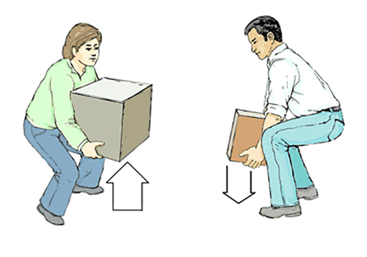
Hazard Alert: Back Strain Injuries
Intended audience: All Employees
Incident Summaries
Back injuries were sustained resulting in lost time injuries when employees were carrying out the following activities:
lifting a compressor to place it onto an adjustable height cart
lifting heavy waste bags above shoulder height into garbage bins
Working outside the scope of regular job duties by moving furniture
Investigation Findings
Hazard Assessment Control Form (HACF) did not identify “material handling” as a task
The Safe Lifting Training online course was not completed
Improper body mechanics were employed
Employees lifted loads too heavy for their physical capabilities
Task was not part of regular job duties
Actions Taken
HACFs reviewed and updated to ensure all tasks, hazards, and controls have been identified
Communications regarding importance of pausing to assess the task and asking for assistance to lift heavy or awkward loads
Key Takeaways
Ensure HACFs are updated and include all hazards and appropriate controls.
If you are lifting, carrying, pushing, pulling items as part of your regular job take the Safe Lifting Training course through ELM and use proper body mechanics.
Before lifting something, pause and decide if you can lift and move the item safely — ask for help if you’re unsure.
Do not move furniture with your co-workers. Instead, submit a Furnishing Service Request form to Supply Chain Management.
PHOTO
Source: WorkSafe BC

